Slide 1

Importing and Handling Data
https://moodle.ucl.ac.uk/course/view.php?id=22765

Slide 2
Importing and Handling Data
Overview
Saving and loading Matlab format data
Saving and loading Excel and other common format data files
Manipulating the contents of matrices or cell arrays (horzcat, vertcat, transpose, sort)
Accessing / ‘indexing’ the contents of matrices or cell arrays (find, logical indexing)

Slide 3
Saving and Loading Matlab Format Data
Variables in the workspace can be saved to disk as a *.mat file
This is achieved by typing save filename
Alternatively, type save(‘filename’) to save data in the exactly the same way
Files will automatically be saved to the current folder
This will overwrite any existing files with the same name, without warning
You can also save specific variables, rather than the whole workspace
This is achieved by listing the variables after the filename:
save(‘filename’, ’variable_name1’, ’variable_name2’)
It is also possible to add variables to an existing file
This is achieved using the command –append after the file and variable names:
save(‘filename’, ’variable_name3’, ’-append’)

Slide 4
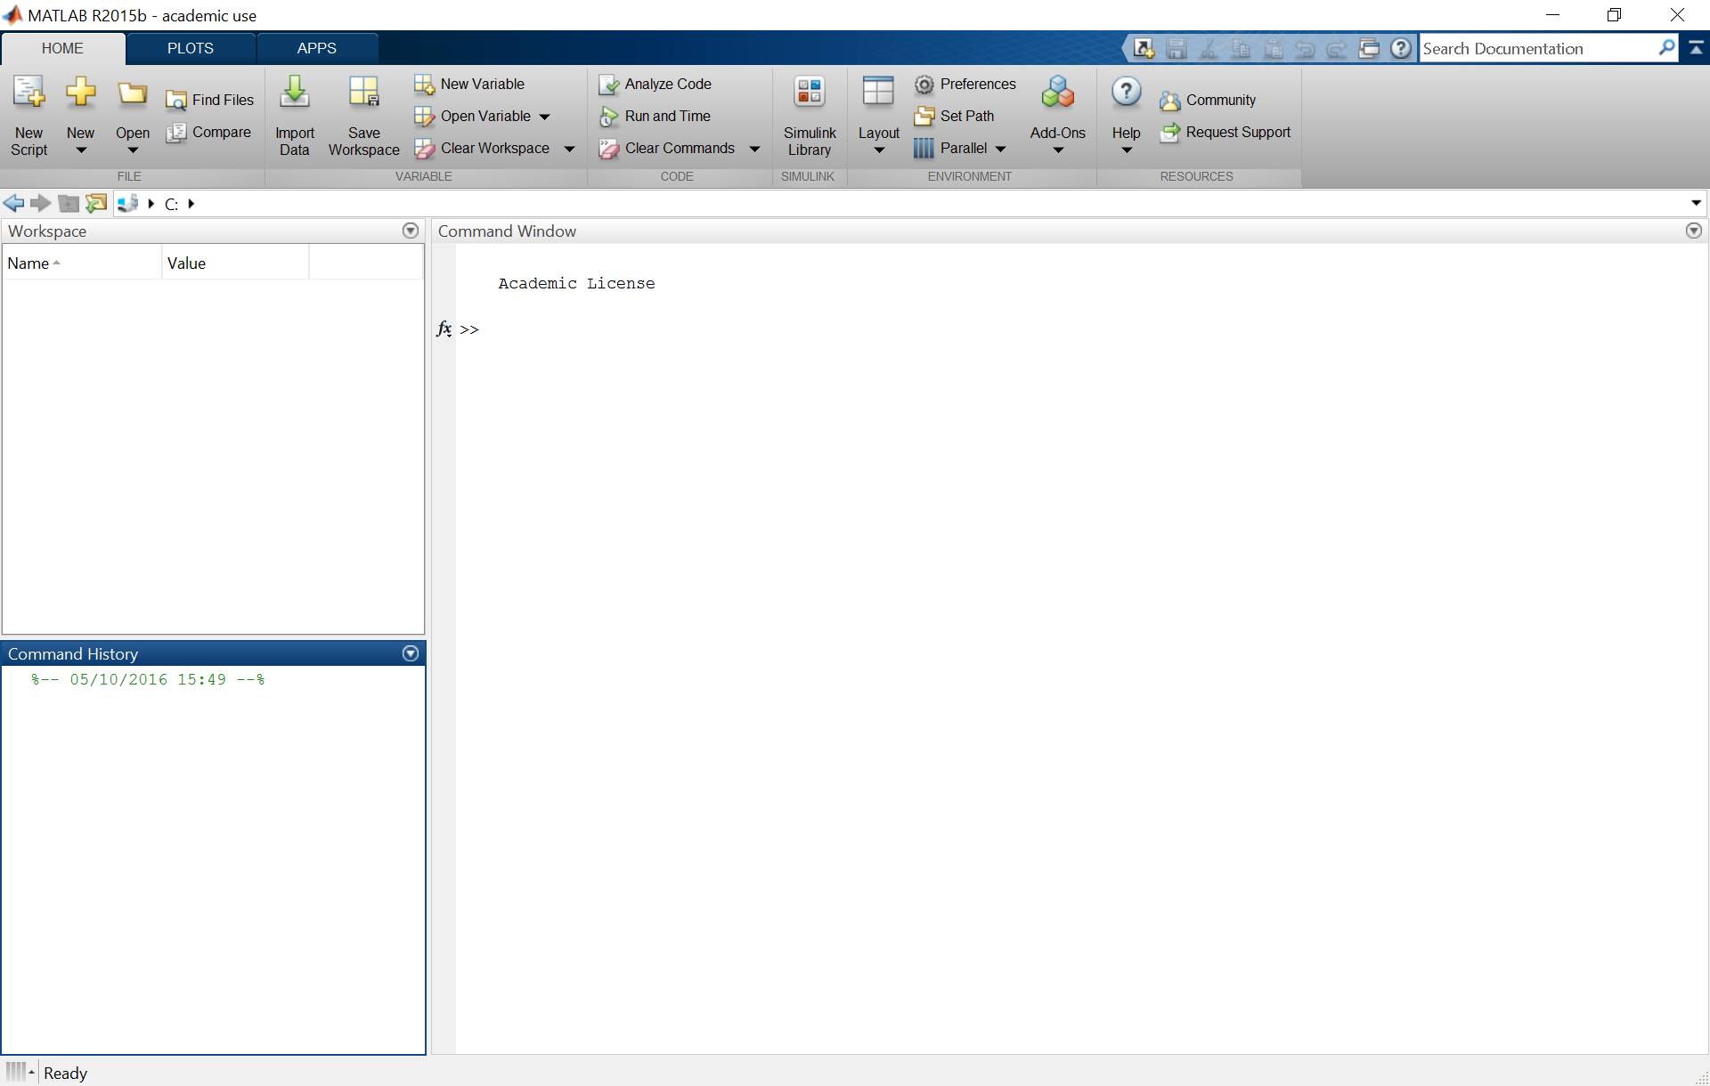
Saving and Loading Matlab Format Data
Current Folder
The exact layout can differ from machine to machine, but the windows are always labelled!

Slide 5
Saving and Loading Matlab Format Data
Files can be loaded into the workspace using the command load filename
Alternatively, type load(‘filename’) to load data in exactly the same way
You do not need to add ‘.mat’ to the filename when saving or loading (but you can)
Data files can be loaded from the current folder or anywhere on the Matlab path
Loading a *.mat file will overwrite any existing variables with the same name
You can also load specific variables, rather than the whole file
This is achieved by listing the variables after the filename:
load(‘filename’, ’variable_name1’, ’variable_name2’)
Data files can also be loaded into fields of a new structure
This is achieved by specifying an output variable for the load function:
newStruct = load(‘filename’);

Slide 6
Loading Excel and CSV Format Data
Matlab can also import data from, and export data to, several other file formats
Two that may be useful are Excel and *.csv format
You can load data from either of these file formats by typing xlsread(‘filename’)
By default, this will only load numerical data from the first worksheet
Text and combined numerical and text data can read by providing multiple outputs:
[numbers,text,combined] = xlsread(‘filename’)
Note that text and combined numerical and text data will be loaded into a cell array
The target worksheet and data indices can be provided as additional inputs:
xlsread(‘filename’, ‘SheetName’, ’A1:C10’)
More recent versions of Matlab also include updated functions that use similar syntax
These include readmatrix, readcell and readvars

Slide 7
Saving Excel and CSV Format Data
You can save data to an Excel file by typing xlswrite(‘filename’, Variable_name)
This will overwrite any existing data within that Excel spreadsheet without warning
You can specify which worksheet and indices to write the data to using:
xlswrite(‘filename’, Variable_name, ‘SheetName’, ‘A1:C10’);
The ‘xlswrite’ function only allows you to save one variable at any one time
This variable can be numeric, text, or a combination of the two in a cell array
If you specify the target spreadsheet cells, you must specify the target worksheet
Note that, in Mac OS, the xlswrite function generates a csv file
You can also save data to a *.csv file by typing csvwrite(‘filename’, Variable_name)
In this case, you can only export one numeric matrix to each output file
More recent versions of Matlab include writematrix, and writecell

Slide 8
Manipulating Data in Matlab
You can horizontally or vertically concatenate data using the ‘horzcat’ and ‘vertcat’ functions, which are equivalent to using square brackets
This can be particularly useful for extracting numeric data from a cell array
You can organise data within an array into ascending order using the ‘sort’ function:
SortedData = sort(Data);
You can also sort the data along a different axis (i.e. by row, not by column), or into descending order, by providing additional inputs to the ‘sort’ function
You can also retrieve the list of sorted indices by asking for an additional output from the ‘sort’ function
You can transpose a matrix (i.e. switch rows to columns and vice versa) using the ‘transpose’ function, or the inverted comma shortcut:
TransposedData = tranpose(Data);
TransposedData = Data’;

Slide 9
Finding Elements
You can identify the location of specific elements in a matrix using the ‘find’ function
‘Find’ will return the indices of elements that satisfy a user-defined logical expression:
indices = find(Data > 5);
The ‘find’ function can also return the row and column of those elements separately:
[row col] = find(Data > 5);
‘Find’ can also return only the ‘first’ or ‘last’ n indices that satisfy the expression:
[row col] = find(Data > 5, n, ‘first’);
Logical operators can be incorporated to generate more complex conditions:
[row col] = find(Data > 5 & Data < 10);

Slide 10
Logical Indexing
You can also access specific elements in a matrix using logical indexing
Logical indexing is faster and less memory intensive than using the ‘find’ function
It allows you to manipulate specific entries in a vector or matrix in one step
The specific entries are determined by a logical operation (similar to ‘find’):
Indices = Data.Condition==1;
The resulting logical array is then used to access all entries where the result is true
Hence, this method can be used to identify, extract or manipulate specific entries from any vector or matrix of the same size:
Data.Performance(Indices)
Again, logical operators can be incorporated to generate more complex conditions:
Data.Performance(Data.Condition==1 & Data.Block==1)

Slide 11
Any Questions?
d.bush@ucl.ac.uk

